Slide 1
👋 Hello & Welcome
⏳ This session will begin shortly.
While you wait, please download the slides for today’s session from the LevUL up website.
In association with:

Slide 2
Recording
This session will now be recorded. Any further information that you provide during a session is optional and in doing so you give us consent to process this information.
These recordings will be stored by the University of Limerick for one year and may be published on our website during that time.
By taking part in a session you give us your consent to process any information you provide during it.

Slide 3
Make MS Teams work for you; manage your assignments and deadlines
Alexander Kearns & Anna Marie Gildea, Information Technology Division (ITD

Slide 5
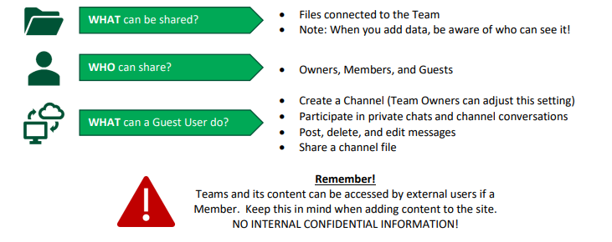

Slide 7
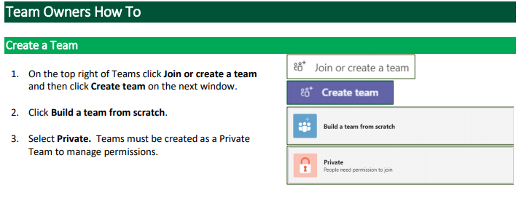
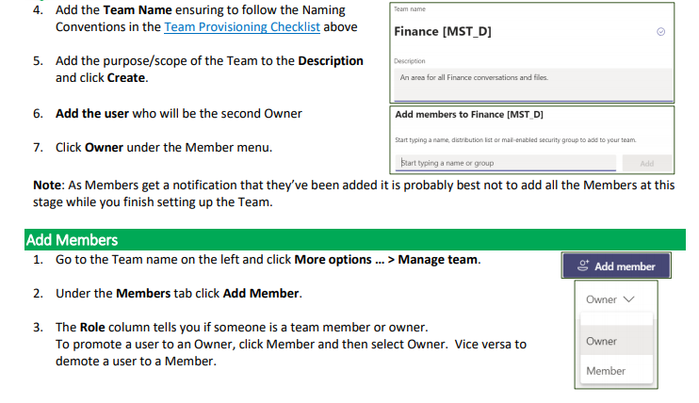

Slide 8
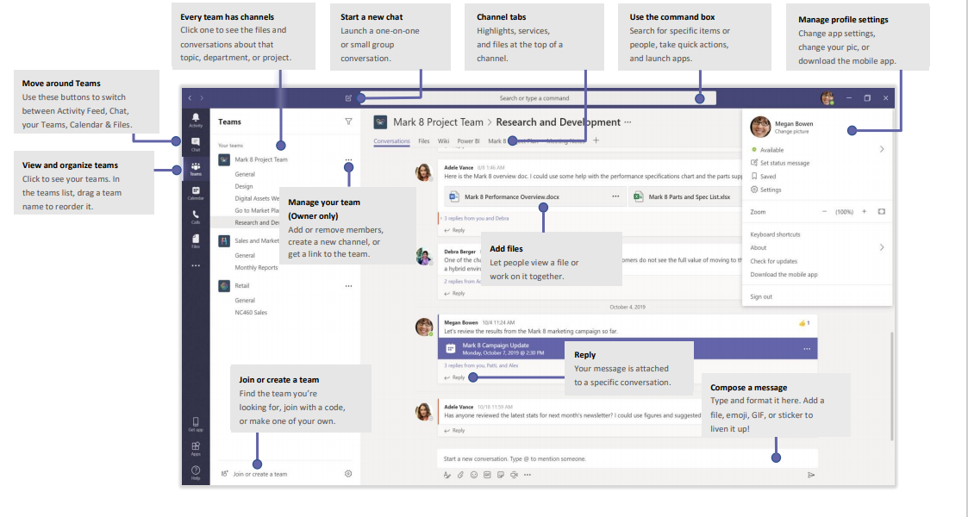

Slide 9
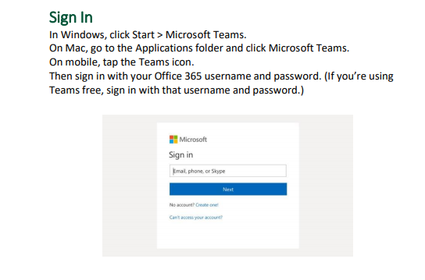
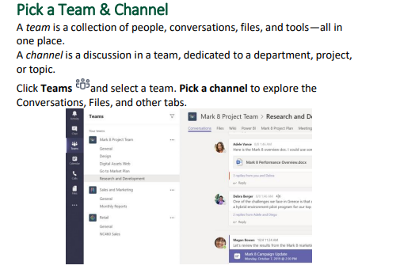
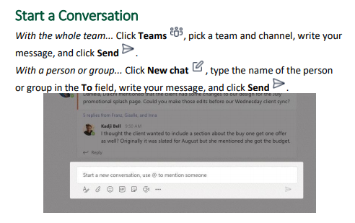
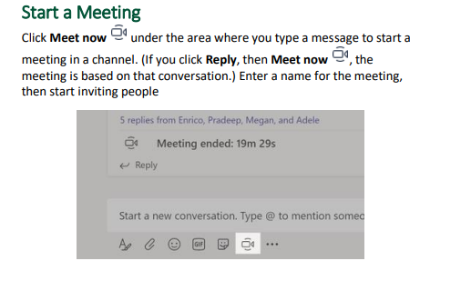

Slide 10
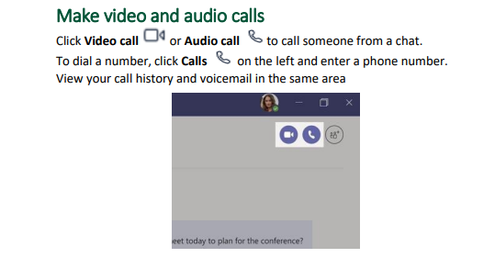
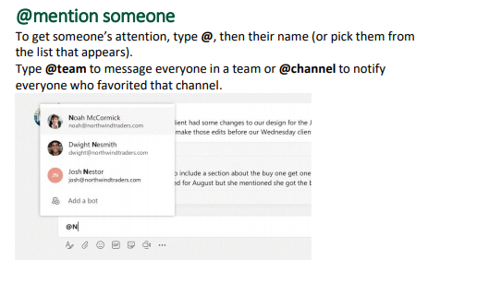
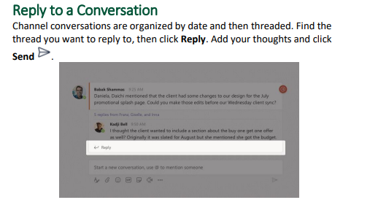
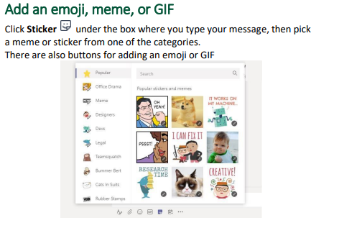

Slide 11
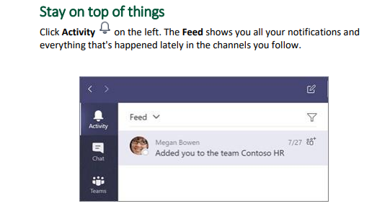
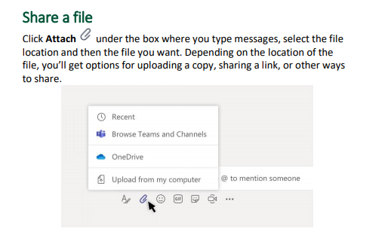
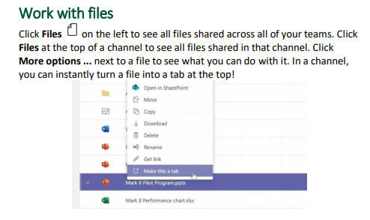
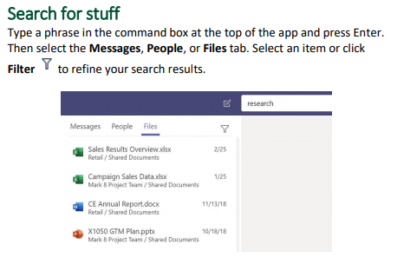

Slide 12
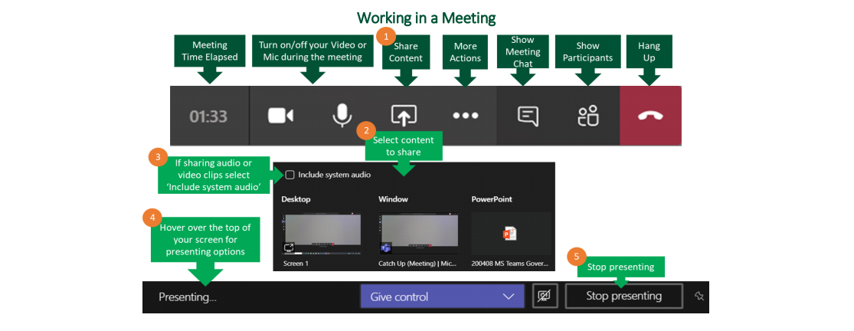

Slide 13
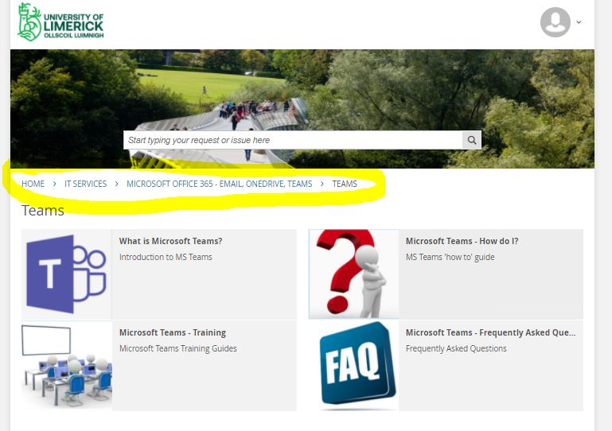
Where To find more information on MS Teams ? https://ul.topdesk.net/

Slide 14
Microsoft Teams – Training Guides
ITD have produced a Team Owners Guide and a Team Members Guide which will help you learning the basics and get started with Teams.
MS Teams safe meeting guidelines. This has good info on how to safely manage a teams meeting. https://ulsites.ul.ie/itd/node/128921
Live, online training: https://aka.ms/TeamsLiveTraining
On-demand training: https://aka.ms/TeamsOnDemand
Self-guided how-to articles: https://support.office.com
Quick how-to videos: https://aka.ms/TeamsTraining
Quick start guide: https://aka.ms/TeamsQuickStartGuide
Tip for working from home: https://aka.ms/WFHTips

Slide 15
As a Team Owner you will receive an email notification prior to expiration of the group where you will have the ability to renew the group if still required.
Team Owners are responsible for ensuring any files worked on within the Teams Files should be relocated to the appropriate ITD supported solutions for document storage (SharePoint, OneDrive or File Share).
When a group expires, the group is deleted one day after the expiration date.

Slide 16
Microsoft Teams – Breakout Room Guide

Slide 17
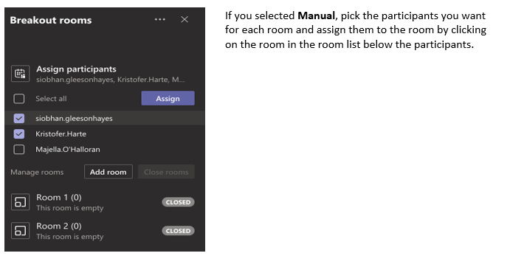
Microsoft Teams – Breakout Room Guide

Slide 18
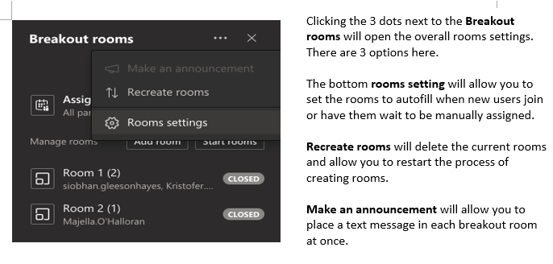
Microsoft Teams – Breakout Room Guide

Slide 19
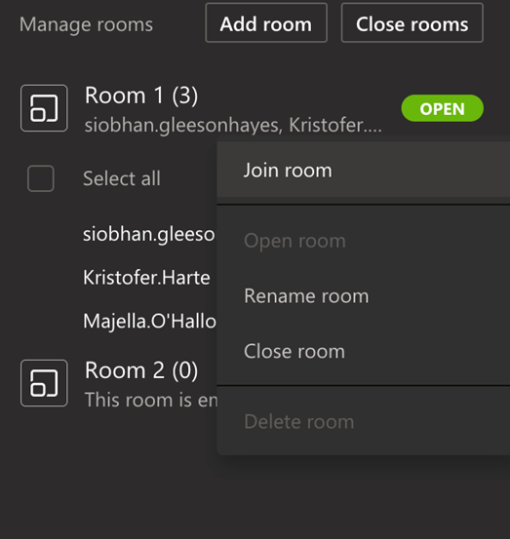
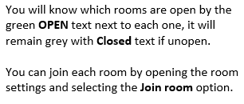
Microsoft Teams – Breakout Room Guide

Slide 20
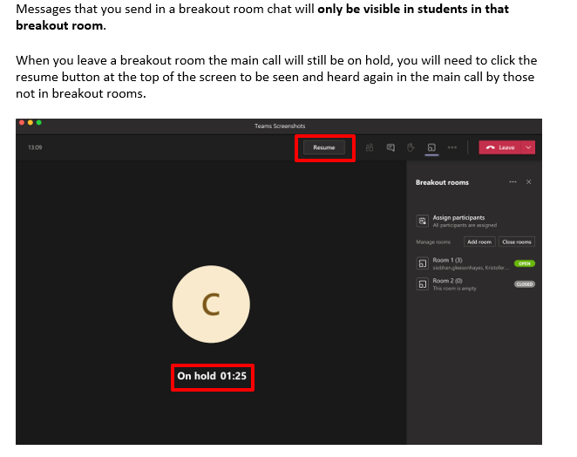
Microsoft Teams – Breakout Room Guide

Slide 21
Microsoft Teams – Breakout Room Guide

Slide 22
Microsoft Teams – Breakout Room Guide FAQ
For best practice it is recommended to close all rooms, bringing all participants back to the main lobby before ending the meeting.
As noted at the beginning of this guide, currently only the organiser of a meeting can create breakout rooms.
Any files from the breakout rooms can be shared in the main meeting once everyone is back together and will be available afterwards in the meeting chat.
If you are the organiser of a meeting and cannot create breakout rooms make sure that the new meeting experience is enabled (Teams -> Settings -> General -> Check “Turn on new meeting experience”)
The meeting organizer can record a Breakout Room. To record a Breakout Room, the organizer must be in the room to start the recording. The organizer can leave the room and the recording will continue.
Click More Actions ⋯ and select Start Recording.

Slide 23
Raise a ticket by logging a call at https://ul.topdesk.net
If you have any issues, please contact ITD (Information Technology Division). Tell us as much information as you can i.e., location, room, device, software and version etc. This will help us to improve our service to you.

